Slide 1
Implementation and Comparision of ECG Data Reduction Algorithms

Slide 2
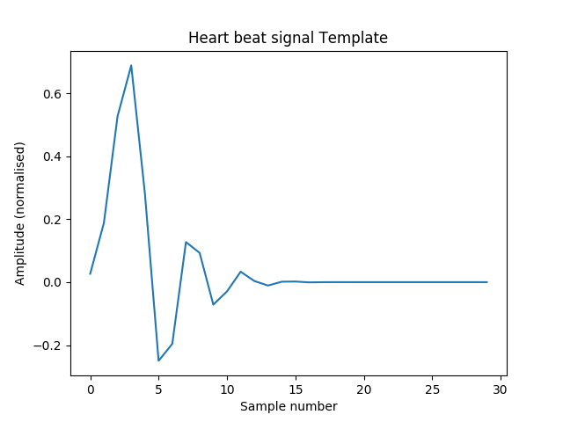
What is ECG?
An electrocardiogram (ECG or EKG) is a measure of how the electrical activity of the heart changes over time as action potentials propagate throughout the heart during each cardiac cycle.

Slide 3
Goals of Data Reduction
To reduce Transmission Bandwidth
To remove non-significant data
To reduce noise

Slide 4
Algorithms Implemented
Amplitude Zone Time Epoch Coding (AZTEC)
Turning Point(TP)
Discrete Cosine Transform(DCT)

Slide 5
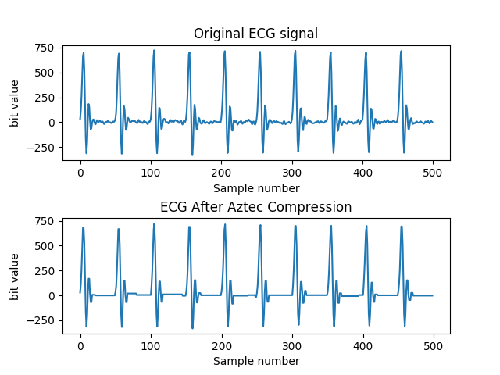
AZTEC

Slide 6
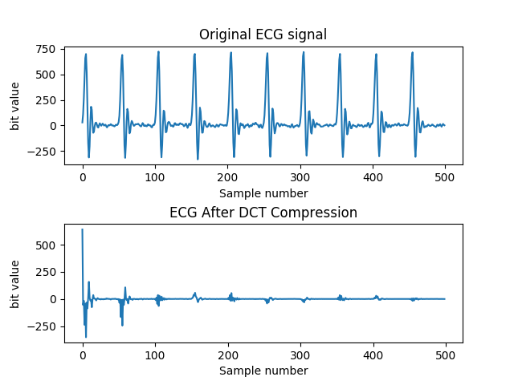
DCT

Slide 7
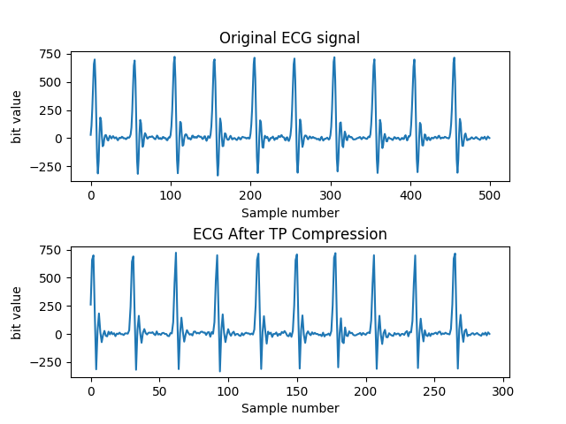
TP

Slide 8
Results obtained
Algorithm | Average Data Loss | Compression Ratio | Data Encryption | Relevence to Original Data
AZTEC | 0.23024542 | 1.002004008 | Not Present | High
TP | 9768.49746 | 1.718213058 | Not Present | Moderate
DCT | 3938.80691 | 1.002004008 | Present | Low

